Slide 1
Informed Search (Best-first search, Greedy best-first search, A* search, Local Search)
(Based on slides of Bart Selman)

Slide 2
Search
Search strategies determined by choice of node (in queue) to expand
Uninformed search:
Distance to goal not taken into account
Informed search :
Information about cost to goal taken into account
Aside: “Cleverness” about what option to explore next, almost seems a hallmark of intelligence. E.g., a sense of what might be a good move in chess or what step to try next in a mathematical proof. We don’t do blind search…

Slide 3
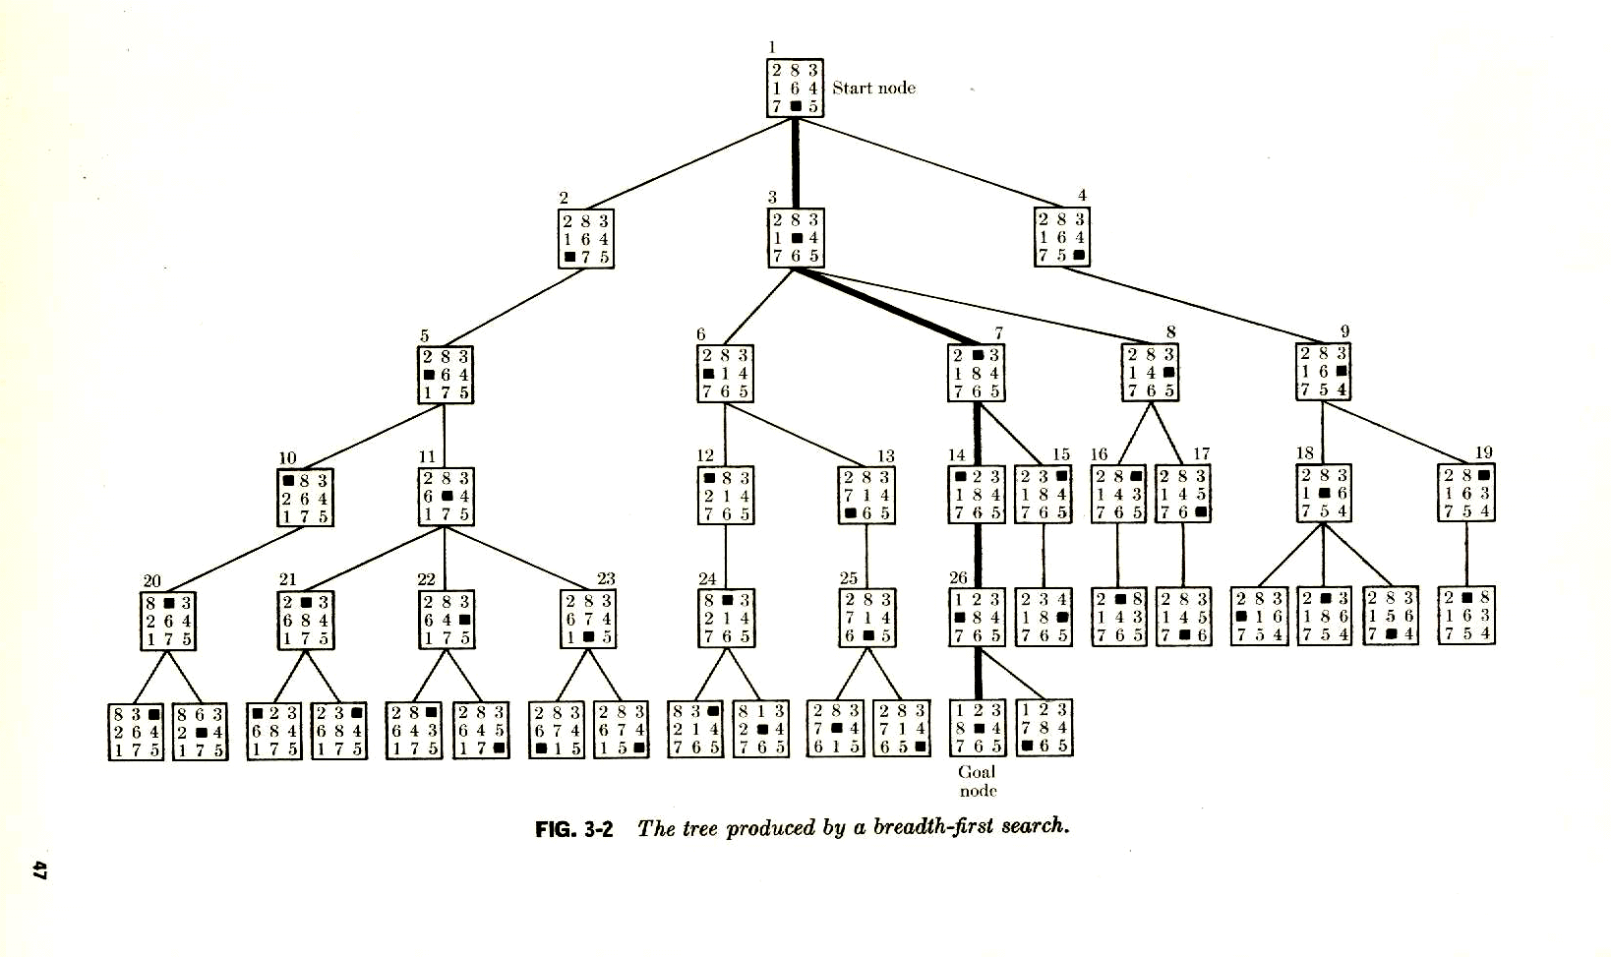
d = min dist. to goal
Reminder: Perfect distance
to goal info.
Eliminates search.
d = 5
Start state
d >= 5
Select
d = 4
d >= 4
d >= 4
Select
d = 3
d >= 3
d = 2
Select
Select
d = 1
Select
d = 0
d >= 1
Goal
A breadth-first search tree.
Practice:
Only have estimate of distance to goal (“heuristic information”).

Slide 4
Basic idea: State evaluation function can effectively guide search.
Also in multi-agent settings. (Chess: board eval.)
Reinforcement learning: Learn the state eval function.
Start state
Goal
A breadth-first search tree.
Perfect “heuristics,” eliminates search.
Approximate heuristics, significantly reduces search.
Best (provably) use of search heuristic info: Best-first / A* search.

Slide 5
Outline
Best-first search
Greedy best-first search
A* search
Heuristics

Slide 6
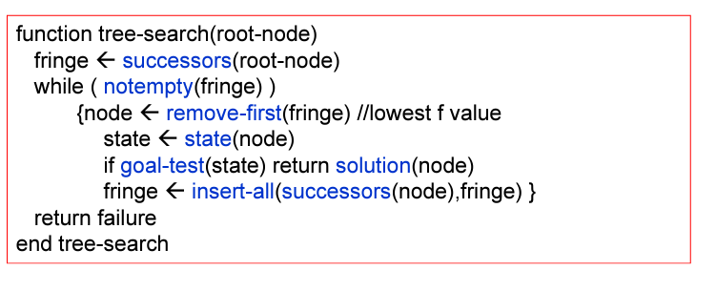
General Tree Search Paradigm

Slide 7
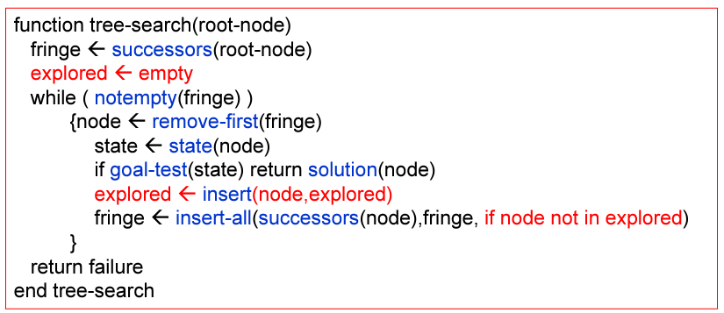
General Tree Search Paradigm

Slide 8
How to take information into account? Best-first search.
Idea : use an evaluation function for each node
Estimate of “desirability” of node
Expand most desirable unexpanded node first (“best-first search”)
Heuristic Functions :
f: States → Numbers
f(n): expresses the quality of the state n
Allows us to express problem-specific knowledge,
Can be imported in a generic way in the algorithms.
Use uniform-cost search. See Figure 3.14 but use f(n) instead of path cost g(n).
Queuing based on f(n):
Order the nodes in fringe in decreasing order of desirability
Special cases:
greedy best-first search
A* search

Slide 9
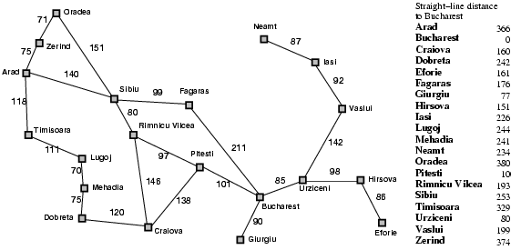
Romanian path finding problem
Base eg on GPS info.
No map needed.
Straight-line
dist. to Bucharest
374
253
329
Searching for good path from Arad to Bucharest,
what is a reasonable “desirability measure” to expand nodes
on the fringe?

Slide 10
Greedy best-first search
Evaluation function at node n, f(n) = h(n) (heuristic)
= estimate of cost from n to goal
e.g., h_{SLD}(n) = straight-line distance from n to Bucharest
Greedy best-first search expands the node that
appears to have shortest path to goal.
Idea: those nodes may lead to solution quickly.
Similar to depth-first search: It prefers to follow a single
path to goal (guided by the heuristic), backing up when it
hits a dead-end.

Slide 11

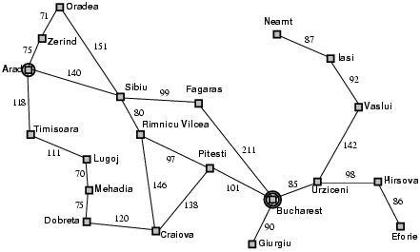
Greedy best-first search example

Slide 12
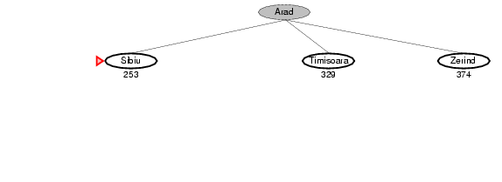
Greedy best-first search example

Slide 13
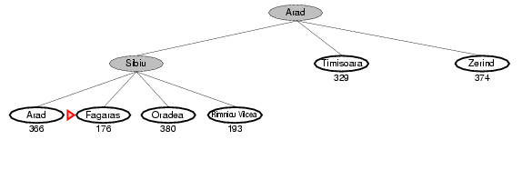
Greedy best-first search example

Slide 14
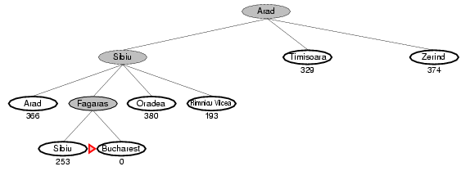
Greedy best-first search example
So, Arad --- Sibiu --- Fagaras --- Bucharest
140+99+211 = 450
Is it optimal?
What are we ignoring?
Also, consider going from
Iasi to Fagaras – what can happen?

Slide 15
Properties of greedy best-first search
Complete? No – can get stuck in loops, e.g.,
Iasi → Neamt → Iasi → Neamt…
But, complete in finite space with repeated state elimination.
Time? O(b^{m}) (imagine nodes all have same distance estimate to goal)
but a good heuristic can give dramatic improvement → Becomes more similar to depth-first search, with reduced branching.
Space? O(b^{m}) -- keeps all nodes in memory
Optimal?
How can we fix this?
No!
b: maximum branching factor of the search tree
d: depth of the least-cost solution
m: maximum depth of the state space (may be ∞)

Slide 16
A* search
Note: Greedy best-first search expands the node that appears to have shortest path to goal. But what about cost of getting to that node? Take it into account!
Idea: avoid expanding paths that are already expensive
Evaluation function f(n) = g(n) + h(n)
g(n) = cost so far to reach n
h(n) = estimated cost from n to goal
f(n) = estimated total cost of path through n to goal
Aside: do we still have “looping problem”?
Iasi to Fagaras:
Iasi → Neamt → Iasi → Neamt…
No! We’ll eventually get out of it. g(n) keeps going up.

Slide 17

A* search example
Using: f(n) = g(n) + h(n)

Slide 18
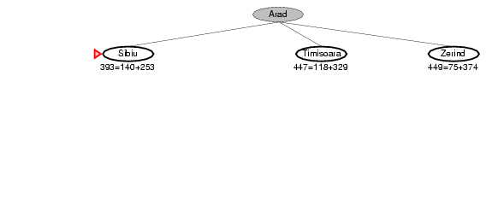
A* search example
Using: f(n) = g(n) + h(n)

Slide 19
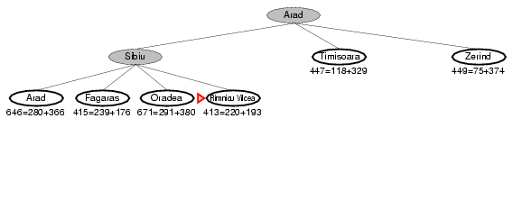
A* search example
Using: f(n) = g(n) + h(n)

Slide 20
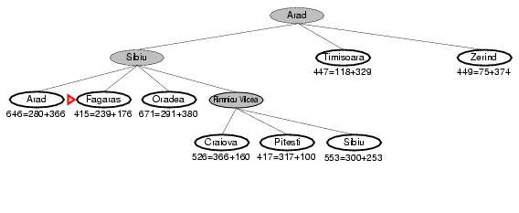
A* search example
Using: f(n) = g(n) + h(n)

Slide 21
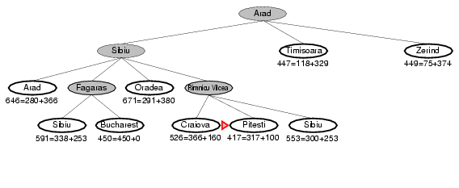
A* search example
Using: f(n) = g(n) + h(n)
What happens if
h(Pitesti) = 150?
Bucharest appears on the fringe
but not selected for expansion
since its cost (450)
is higher than that of Pitesti (417).
Important to understand for the proof of
optimality of A*

Slide 22
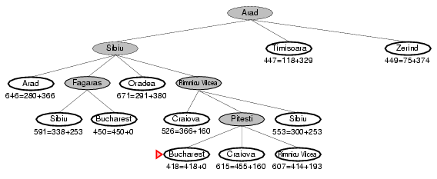
A* search example
Using: f(n) = g(n) + h(n)
Arad --- Sibiu --- Rimnicu --- Pitesti --- Bucharest
Claim: Optimal path found!
1) Can it go wrong?
Note: Best first
Arad --- Sibiu --- Fagaras --- Bucharest
2) What’s special about “straight distance” to goal?
It underestimates true path
distance!
Uniform cost search
3) What if all our estimates to goal are 0? Eg h(n) = 0
4) What if we overestimate?
5) What if h(n) is true distance (h*(n))?
What is f(n)?
Shortest dist. through n --- perfect heuristics --- no search

Slide 23
A* properties
Under some reasonable conditions for the heuristics, we have:
Complete
Yes, unless there are infinitely many nodes with f(n) < f(Goal)
Time
Sub-exponential grow when
So, a good heuristics can bring exponential search down
significantly!
Space
Fringe nodes in memory. Often exponential. Solution: IDA*
Optimal
Yes (under admissible heuristics; discussed next)
Also, optimal use of heuristics information!
Widely used. After almost 40 yrs, still new applications found.
Also, optimal use of heuristic information.
Provably: Can’t do better!
Notes:
The error in the heuristic function grows no faster than the logarithm of the actual path cost.

Slide 24
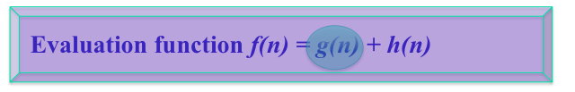
Heuristics: (1) Admissibility
A heuristic h(n) is admissible if for every node n, h(n) ≤ h*(n), where h*(n) is the true cost to reach the goal state from n.
An admissible heuristic never overestimates the cost to reach the goal, i.e., it is optimistic. (But no info of where the goal is if set to 0.)
Example: h_{SLD}(n) (never overestimates the actual road distance)
Note: it follows that h(goal) = 0.
Note: less optimistic heuristic push nodes to be expanded
later. Can prune a lot more.

Slide 25
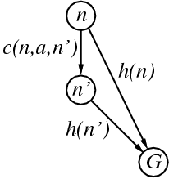
Heuristics: (2) Consistency
A heuristic is consistent (or monotone) if for every node n, every successor n' of n generated by any action a,
h(n) ≤ c(n,a,n') + h(n')
(form of the triangle inequality)
If h is consistent, we have
f(n') = g(n') + h(n')
= g(n) + c(n,a,n') + h(n')
≥ g(n) + h(n)
= f(n)
i.e., f(n) is non-decreasing along any path.
f(n') ≥ f(n)
→ sequence of nodes expanded by A* is in nondecreasing order of f(n)
→ the first goal selected for expansion must be an optimal goal.
Note: Monotonicity is a stronger condition than admissibility.
Any consistent heuristic is also admissible.
(Exercise 3.29)

Slide 26
A*: Tree Search vs. Graph Search
TREE SEARCH (See Fig. 3.7; used in earlier examples):
If h(n) is admissible, A* using tree search is optimal.
GRAPH SEARCH (See Fig. 3.7) A modification of tree search that includes an “explored set” (or “closed list”; list of expanded nodes to avoid re-visiting the same state); if the current node matches a node on the closed list, it is discarded instead of being expanded. In order to guarantee optimality of A*, we need to make sure that the optimal path to any repeated state is always the first one followed:
If h(n) is monotonic, A* using graph search is optimal.

Slide 27
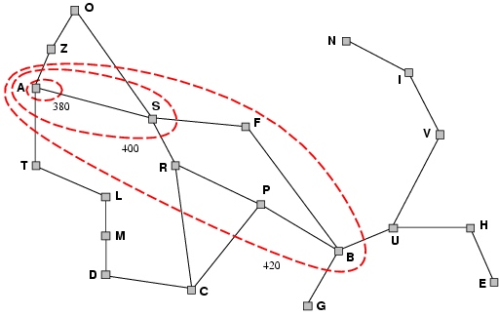
Intuition: Contours of A*
A* expands nodes in order of increasing f value.
Gradually adds "f-contours" of nodes.
Contour i has all nodes with f <= f_{i}, where f_{i} < f_{i+1}
Note: with uniform cost (h(n)=0) the bands will be circular around the start state.
A* expands all nodes
with f(n)<C*
Uniform-cost (h(n)=0)
expands in circles.
Completeness (intuition)
As we add bands of increasing f, we must eventually reach a band where f is equal to the cost of the path to a goal state. (assuming b finite and step cost exceed some positive finite ε).
380
400
Optimality (intuition)
1st solution found (goal node expanded) must be an optimal one since goal nodes in subsequent contours will have higher f-cost and therefore higher g-cost (since h(goal)=0)
420
Notes:
Why1 – H(goal)=0;
Why 2 - Finite number of nodes with cost less than or eqaul to C*

Slide 28
A* Search: Optimality
Theorem:
A* used with a consistent heuristic ensures optimality with graph search.

Slide 29
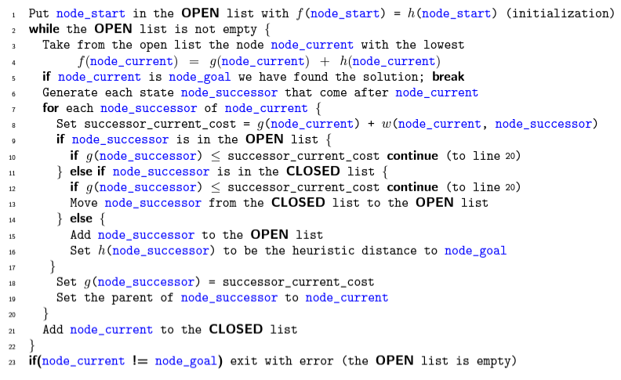
A* Search: Pseudocode
Open List: consists on nodes that have been visited but not expanded (meaning that sucessors have not been explored yet ). This is the list of pending tasks.
Close List: consists on nodes that have been visited and expanded (sucessors have been explored already and included in the openlist, if this was the case).

Slide 30
Proof:
If h(n) is consistent, then the values of f(n) along any path are non-decreasing. See consistent heuristics slide.
(2) Whenever A* selects a node n for expansion, the optimal path to that node has been found. Why?
Assume not. Then, the optimal path, P, must have some not yet
expanded nodes. (*) Thus, on P, there must be an unexpanded
node n` on the current frontier (because of graph separation;
fig. 3.9; frontier separates explored region from unexplored
region). But, because f is nondecreasing along any path, n`
would have a lower f-cost than n and would have been selected
first for expansion before n. Contradiction.
From (1) and (2), it follows that the sequence of nodes expanded by A*
using Graph-Search is in non-decreasing order of f(n). Thus, the first
goal node selected must have the optimal path, because f(n) is the true
path cost for goal nodes (h(Goal) = 0), and all later goal nodes have paths
that are are at least as expensive. QED
(*) requires a bit of thought. Must argue that there cannot be a shorter
path going only through expanded nodes (by contradiction).

Slide 31
Note: Termination / Completeness
Termination is guaranteed when the number of nodes
with is finite.
None-termination can only happen when
There is a node with an infinite branching factor, or
There is a path with a finite cost but an infinite number of nodes along it.
Can be avoided by assuming that the cost of each action is larger than a positive constant d
≤

Slide 32
A* Optimal in Another Way
It has also been shown that A* makes optimal use of the heuristics in the sense that there is no search algorithm that could expand fewer nodes using the heuristic information (and still find the optimal / least cost solution.
So, A* is “the best we can get” (in this setting).
Note: We’re assuming a search based approach with states/nodes, actions on them leading to other states/nodes, start and goal states/nodes.

Slide 33
Heuristics

Slide 34
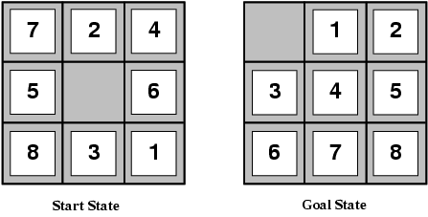
8-Puzzle
Slide the tiles horizontally or vertically into the empty space until the
configuration matches the goal configuration
What’s the branching factor?
(slide “empty space”)
About 3, depending on location of empty tile:
middle → 4; corner → 2; edge → 3
The average solution cost for a randomly generated 8-puzzle instance → about 22 steps
So, search space to depth 22 is about 3²² ≈ 3.1 × 10¹⁰ states.
Reduced to by a factor of about 170,000 by keeping track of repeated states
(9!/2 = 181,440 distinct states) note: 2 sets of disjoint states. See exercise 3.4
But: 15-puzzle → 10¹³ distinct states!
We’d better find a good heuristic
to speed up search! Can you suggest one?
Note: “Clever” heuristics now allow us to solve the 15-puzzle in
a few milliseconds!

Slide 35
Admissible heuristics
E.g., for the 8-puzzle:
h₁(n) = number of misplaced tiles
h₂(n) = total Manhattan distance
(i.e., no. of steps from desired location of each tile)
h₁(Start) = ?
h₂(Start) = ?
Why are heuristics admissible?
Which is better?
How can we get the optimal heuristics? (Given H_opt(Start) = 26. How would we find the next board on the optimal path to the goal?)
8
3+1+2+2+2+3+3+2 = 18
True cost = 26
Desired properties heuristics:
(1) consistent (admissible)
(2) As close to opt as we can get (sometimes go a bit over…)
(3) Easy to compute! We want to explore many nodes.
Note: each empty-square-move = 1 step tile move.

Slide 36
Comparing heuristics
Effective Branching Factor, b*
If A* generates N nodes to find the goal at depth d
b* = branching factor such that a uniform tree of depth d contains N+1 nodes (we add one for the root node that wasn’t included in N)
N+1 = 1 + b* + (b*)² + … + (b*)^{d}
E.g., if A* finds solution at depth 5 using 52 nodes, then the effective branching factor is 1.92.
b* close to 1 is ideal
because this means the heuristic guided the A* search is
closer to ideal (linear).
If b* were 100, on average, the heuristic had to consider 100 children for each node
Compare heuristics based on their b*

Slide 37
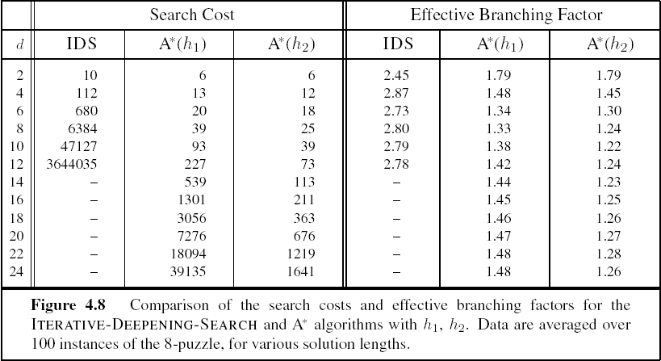
Comparison of heuristics
h2 indeed significantly better than h1
d – depth of goal node

Slide 38
Dominating heuristics
h₂ is always better than h₁
Because for any node, n, h₂(n) >= h₁(n). (Why?)
We say h₂ dominates h₁
It follows that h1 will expand at least as many nodes as h2.
Because:
Recall all nodes with f(n) < C* will be expanded.
This means all nodes, h(n) + g(n) < C*, will be expanded.
So, all nodes n where h(n) < C* - g(n) will be expanded
All nodes h₂ expands will also be expanded by h₁ and because h₁ is smaller, others may be expanded as well

Slide 39
Inventing admissible heuristics: Relaxed Problems
Can we generate h(n) automatically?
Simplify problem by reducing restrictions on actions
A problem with fewer restrictions on the actions is called a
relaxed problem

Slide 40
Examples of relaxed problems
Original: A tile can move from square A to square B iff
(1) A is horizontally or vertically adjacent to B and (2) B is blank
Relaxed versions:
A tile can move from A to B if A is adjacent to B (“overlap”; Manhattan distance)
A tile can move from A to B if B is blank (“teleport”)
A tile can move from A to B (“teleport and overlap”)
Key: Solutions to these relaxed problems can be computed without search
and therefore provide a heuristic that is easy/fast to compute.
This technique was used by ABSOLVER (1993) to invent heuristics for the 8-puzzle
better than existing ones and it also found a useful heuristic for famous Rubik’s
cube puzzle.

Slide 41
Inventing admissible heuristics: Relaxed Problems
The cost of an optimal solution to a relaxed problem is an admissible heuristic
for the original problem. Why?
1) The optimal solution in the original problem is also a solution to the relaxed problem (satisfying in addition all the relaxed constraints). So, the solution cost matches at most the original optimal solution.
2) The relaxed problem has fewer constraints. So, there may be other, less
expensive solutions, given a lower cost (admissible) relaxed solution.
What if we have multiple heuristics available? I.e., h_1(n), h_2(n), …
h(n) = max {h₁(n), h₂(n), …, h_{m}(n)}
If component heuristics are admissible so is the composite.

Slide 42
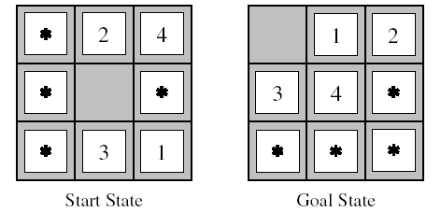
Inventing admissible heuristics: Sub-problem solutions as heuristic
What is the optimal cost of solving some portion of original problem?
subproblem solution is heuristic of original problem

Slide 43
Pattern Databases
Store optimal solutions to subproblems in database
We use an exhaustive search to solve every permutation of the 1,2,3,4-piece subproblem of the 8-puzzle
During solution of 8-puzzle, look up optimal cost to solve the 1,2,3,4-piece sub-problem and use as heuristic
Other configurations can be considered

Slide 44
Inventing admissible heuristics: Learning
Also automatically learning admissible heuristics
using machine learning techniques, e.g., inductive learning and reinforcement learning.
Generally, you try to learn a “state-evaluation” function or “board evaluation” function. (How desirable is state in terms of getting to the goal?) Key: What “features / properties” of state are most useful?
More later…
Notes:
Could also build pattern database while solving cases of the 8-puzzle
Must keep track of intermediate states and true final cost of solution
Inductive learning builds mapping of state features -> cost
Because too many permutations of actual states
Construct important features to reduce size of space

Slide 45
Local Search (Hill-climbing, Simulated Annealing)
(Based on slides of Mausam, Padhraic Smyth, Stuart Russell, Rao Kambhampati, Raj Rao, Dan Weld, Jim Martin…)

Slide 46
Outline
Local search techniques and optimization
Hill-climbing
Simulated annealing
Issues with local search

Slide 47
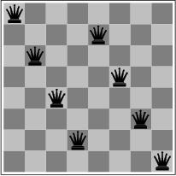
Local search and optimization
Previous lecture: path to goal is solution to problem
systematic exploration of search space.
This lecture: a state is solution to problem
for some problems path is irrelevant.
E.g., 8-queens
Different algorithms can be used
Depth First Branch and Bound
Local search

Slide 48
Goal Satisfaction
Optimization
reach the goal node
Constraint satisfaction
optimize(objective fn)
Constraint Optimization
You can go back and forth between the two problems
Typically in the same complexity class
© Mausam

Slide 49
Local search and optimization
Sometimes referred to as iterative improvement or local search.
We’ll talk about three simple but effective techniques:
Hillclimbing
Random Restart Hillclimbing
Simulated Annealing

Slide 50
Optimization Framework
Working with 1 state in memory
No agenda/queue/fringe…
Usually
Usually generating new states from this 1 state in an attempt to improve things
Goal notion is slightly different
Normally solutions are easy to find
We can compare solutions and say one is better than another
Goal is usually an optimization of some function of the “solution” (cost).

Slide 51
Local search and optimization
Local search
Keep track of single current state
Move only to neighboring states
Ignore paths
Advantages:
Use very little memory
Can often find reasonable solutions in large or infinite (continuous) state spaces.
“Pure optimization” problems
All states have an objective function
Goal is to find state with max (or min) objective value
Does not quite fit into path-cost/goal-state formulation
Local search can do quite well on these problems.

Slide 52
Trivial Algorithms
Random Sampling
Generate a state randomly
Random Walk
Randomly pick a neighbor of the current state
Both algorithms asymptotically complete.
© Mausam

Slide 53
Hill-climbing Search
Generate nearby successor states to the current state based on some knowledge of the problem.
Pick the best of the bunch and replace the current state with that one.
Loop (until?)
© Mausam

Slide 54
Hill-climbing Search
Implicit in this scheme is the notion of a neighborhood that in some way preserves the cost behavior of the solution space.
The successor function is where the intelligence lies in hill-climbing search
It has to be conservative enough to preserve significant “good” portions of the current solution
© Mausam

Slide 55
Hill-climbing (Greedy Local Search) max version
function HILL-CLIMBING( problem) return a state that is a local maximum
input: problem, a problem
local variables: current, a node.
neighbor, a node.
current ← MAKE-NODE(INITIAL-STATE[problem])
loop do
neighbor ← a highest valued successor of current
if VALUE [neighbor] ≤ VALUE[current] then return STATE[current]
current ← neighbor
min version will reverse inequalities and look for lowest valued successor

Slide 56
Hill-climbing search
“a loop that continuously moves towards increasing value”
terminates when a peak is reached
Aka greedy local search
Value can be either
Objective function value
Heuristic function value (minimized)
Hill climbing does not look ahead of the immediate neighbors
Can randomly choose among the set of best successors
if multiple have the best value
“climbing Mount Everest in a thick fog with amnesia”

Slide 57
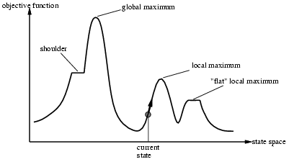
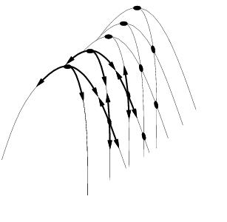
“Landscape” of Hill-climbing search
Hill Climbing gets stuck in local minima
depending on?

Slide 58

Example: n-queens
Put n queens on an n x n board with no two queens on the same row, column, or diagonal
Is it a satisfaction problem or optimization?

Slide 59
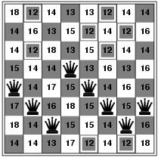
Hill-climbing search: 8-queens problem
Need to convert to an optimization problem
h = number of pairs of queens that are attacking each other
h = 17 for the above state

Slide 60
Search Space
State
All 8 queens on the board in some configuration
Successor function
move a single queen to another square in the same column.
Example of a heuristic function h(n):
the number of pairs of queens that are attacking each other
(so we want to minimize this)

Slide 61
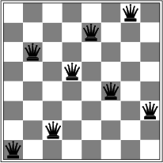
Hill-climbing search: 8-queens problem
Is this a solution?
What is h?

Slide 62
Hill-climbing on 8-queens
Randomly generated 8-queens starting states…
14% the time it solves the problem
86% of the time it get stuck at a local minimum
However…
Takes only 4 steps on average when it succeeds
And 3 on average when it gets stuck
(for a state space with 8^8 =~17 million states)

Slide 63
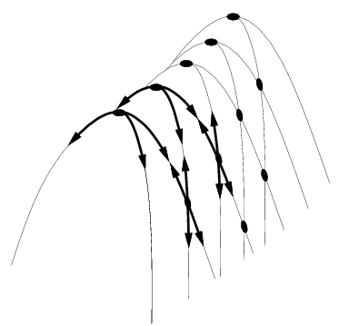
Hill Climbing Drawbacks
Local maxima
Plateaus
Diagonal ridges

Slide 64
Escaping Shoulders: Sideways Move
If no downhill (uphill) moves, allow sideways moves in hope that algorithm can escape
Need to place a limit on the possible number of sideways moves to avoid infinite loops
For 8-queens
Now allow sideways moves with a limit of 100
Raises percentage of problem instances solved from 14 to 94%
However….
21 steps for every successful solution
64 for each failure

Slide 65
Local Minima/Maxima
Hill-climbing is subject to getting stuck in a variety of local conditions…
Solutions
Random-walk hill-climbing
Random-restart hill-climbing
Hill-climbing with both
Simulated Annealing

Slide 66
Hill-climbing: stochastic variations
Stochastic hill-climbing
Random selection among the uphill moves.
The selection probability can vary with the steepness of the uphill move.
To avoid getting stuck in local minima/maxima
Random-walk hill-climbing
Random-restart hill-climbing
Hill-climbing with both

Slide 67
Hill Climbing: stochastic variations
When the state-space landscape has local minima, any search that moves only in the greedy direction cannot be complete
Random walk, on the other hand, is
asymptotically complete
Idea: Put random walk into greedy hill-climbing

Slide 68
Hill-climbing with random restarts
If at first you don’t succeed, try, try again!
Pretty obvious what this is….
Generate a random start state
Run hill-climbing and store answer
Iterate, keeping the current best answer as you go
Stopping… when?
If you want to pick one local search algorithm, learn this one!!

Slide 69
Hill-climbing with random walk
At each step do one of the two
Greedy: With prob p move to the neighbor with largest value
Random: With prob 1-p move to a random neighbor
Hill-climbing with both
At each step do one of the three
Greedy: move to the neighbor with largest value
Random Walk: move to a random neighbor
Random Restart: Resample a new current state
© Mausam

Slide 70
Simulated Annealing
Based on a metallurgical metaphor
Start with a temperature set very high and slowly reduce it.
Run hillclimbing with the twist that you can occasionally replace the current state with a worse state based on the current temperature and how much worse the new state is.

Slide 71
Simulated Annealing
Simulated Annealing = physics inspired twist on random walk
Basic ideas:
like hill-climbing identify the quality of the local improvements
instead of picking the best move, pick one randomly
say the change in objective function is δ
if δ is positive, then move to that state
otherwise:
move to this state with probability proportional to δ
thus: worse moves (very large negative δ) are executed less often
however, there is always a chance of escaping from local maxima
over time, make it less likely to accept locally bad moves
(Can also make the size of the move random as well, i.e., allow “large” steps in state space)

Slide 72
Simulated annealing
function SIMULATED-ANNEALING( problem, schedule) return a solution state
input: problem, a problem
schedule, a mapping from time to temperature
local variables: current, a node.
next, a node.
T, a “temperature” controlling the prob. of downward steps
current ← MAKE-NODE(INITIAL-STATE[problem])
for t ← 1 to ∞ do
T ← schedule[t]
if T = 0 then return current
next ← a randomly selected successor of current
∆E ← VALUE[next] - VALUE[current]
if ∆E > 0 then current ← next
else current ← next only with probability e^{∆E /T}

Slide 73
Temperature T
high T: probability of “locally bad” move is higher
low T: probability of “locally bad” move is lower
typically, T is decreased as the algorithm runs longer
i.e., there is a “temperature schedule”

Slide 74
Simulated Annealing in Practice
method proposed in 1983 by IBM researchers for solving VLSI layout problems (Kirkpatrick et al, Science, 220:671-680, 1983).
theoretically will always find the global optimum
Other applications: Traveling salesman, Graph partitioning, Graph coloring, Scheduling, Facility Layout, Image Processing, …
useful for some problems, but can be very slow
slowness comes about because T must be decreased very gradually to retain optimality

